Slide 1
Big Data Processing
Jiaul Paik

Slide 2
Topics
Stream Processing
Overview
Challenges
Distributed Stream Processing

Slide 3
Streaming Data Processing: Overview
Stream processing:
continuously incorporating new data to compute a result.
Data is unbounded and has no predetermined beginning or end.
A series of events that arrive at the stream processing system
Examples:
credit card transactions
clicks on a website
sensor readings from Internet of Things devices

Slide 4
Stream Processing: Use Cases
Notifications and alerting
Given some series of events, a notification or alert should be triggered if some sort of event or series of events occurs.
Real-time reporting
real-time dashboards for a employee to look at (server load, # user visiting, etc)
Update data to serve in real time
a web analytics product might continuously track the number of visits to each page
Online machine learning
Credit card fraud detection: company may want to continuously update a model from all customers’ behavior and test each transaction against it

Slide 5
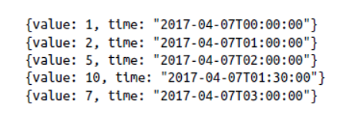
Stream Processing: Issues
Processing out-of-order data based on event time
You want only to trigger some action based on a specific sequence of values received, say for example, 2 -> 10 -> 5
Why this is challenging?
streaming system is going to receive each event individually
the data can reach out of order because of network delay
Volume of data is also very high

Slide 6
Requirements for Stream Processing System
Scalable to large clusters
Quick response time
Simple programming model
Integrated batch & interactive processing

Slide 7
Case study: Conviva, Inc.
Real-time monitoring of online video metadata
HBO, ESPN, …
Two processing stacks
Custom-built distributed stream processing system
1000s complex metrics on millions of video sessions
Requires many dozens of nodes for processing
Hadoop backend for offline analysis
Generating daily and monthly reports
Similar computation as the streaming system
Slides credit: Tathagata Das, UC Berkeley

Slide 8

Stateful Stream Processing
Traditional streaming systems have a record-at-a-time processing model
Each node has mutable state
For each record, update state & send new records
State is lost if node dies!
mutable state
input
records
node 1
node 3
input
records
node 2

Slide 9
Distributed Stream Processing

Slide 10
Discretized Stream Processing
Run a streaming computation as a series of very small, deterministic batch jobs
live data stream
Spark
Streaming
Chop up the live stream into batches of t seconds
Spark treats each batch of data as RDDs and processes them using RDD operations
Finally, the processed results of the RDD operations are returned in batches
batches of t seconds
Spark
processed results

Slide 11
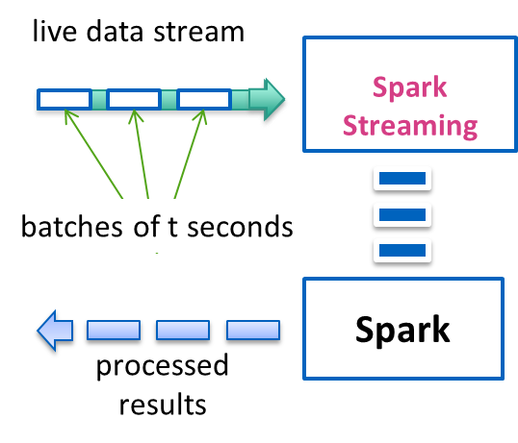
Discretized Stream Processing
Run a streaming computation as a series of very small, deterministic batch jobs
Batch sizes as low as ½ second, latency ~ 1 second
Potential for combining batch processing and streaming processing in the same system

Slide 12
Spark Streaming Context
StreamingContext is the main module for all streaming operations
import org.apache.spark._
import org.apache.spark.streaming._
import org.apache.spark.streaming.StreamingContext._
// Create a local StreamingContext
val conf = new SparkConf().setMaster("local[10]").setAppName(“myApp")
val ssc = new StreamingContext(conf, Seconds(2))

Slide 13
Example: Find hashtags from Twitter
tweets = ssc.twitterStream(username, password)
hashtags = tweets.flatMap(t => getTags(t))
Hashtags.saveAsTextFile(“output”)
time t
time t+1
time t+2
tweets Dstream
flatMap
hashtags
saveAsTextFile

Slide 14
Key concepts
DStream – sequence of RDDs representing a stream of data
Twitter, HDFS, Kafka
Transformations – modify data from on DStream to another
Standard RDD operations – map, countByValue, reduce, join, …
Stateful operations – window, countByValueAndWindow, …
Output Operations – send data to external storage/show on screen
saveAsHadoopFiles – saves to HDFS
foreach – do anything with each batch of results

Slide 15
Example: Count the hashtags
tweets = ssc.twitterStream(username, password)
hashtags = tweets.flatMap(t => getTags(t))
count = hashtags.map(t => (t,1)).reduceByKey(_ + _)

Slide 16
Windowed computations
Allow you to apply transformations over a sliding window of data.
window length - The duration of the window
sliding interval - The interval at which the window operation is performed
1
2
3
4
5
Original Dstream
windowed Dstream
1
2

Slide 17
Window Operations
Window length
Sliding interval
window(WL, SI) | Return a new DStream based on windowed batches of the source DStream.
countByWindow(WL, SI) | Return a sliding window count of elements in the stream.
reduceByWindow(Func, WL, SI) | Return a new single-element stream, by aggregating elements over sliding interval using Func.
reduceByKeyAndWindow(Func, WL, SI, [numTasks]) | Returns a new DStream of (K, V) pairs where the values for each key are aggregated using the given reduce function Func over batches in a sliding window.
countByValueAndWindow(WL, SI, [numTasks]) | Returns a new DStream of (K, V) pairs where the value of each key is its frequency within a sliding window.

Slide 18
Structured Stream Processing

Slide 19
Structured Stream in Spark: Overview
Structured Streaming treats live data stream as a table that is being continuously appended.
Similar to a batch processing model.
Streaming computation as standard batch-like query as on a static table,
Spark runs it as an incremental query on the unbounded input table.

Slide 20
Stream as Unbounded Table
Data stream
Unbounded
table
Appended data

Slide 21
Output Modes
Complete Mode
The entire updated Result Table is written to the external storage.
Append Mode
Only the new rows appended in the Result Table since the last trigger will be written to the external storage.
Update Mode
Only the rows that were updated in the Result Table since the last trigger will be written to the external storage

Slide 22
Querying on Structured Stream: Example
Word count example
1
2
3
(1 second interval)
Time
cat, dog, dog, cat
cat, dog, dog, cat, rat
Input data
cat, dog
Result
(word count)
cat, 1
dog, 1
cat, 2
dog, 2
cat, 2
dog, 2
rat, 1
Output
(complete mode)
output (t=1)
output (t=2)
output (t=3)

Slide 23
Creating streaming DataFrames
Streaming DataFrames can be created through
DataStreamReader interface provided by SparkSession.readStream()

Slide 24
Streaming DataFrames: Input Sources
File source –
Reads files written in a directory as a stream of data.
Files are processed in the order of file modification time.
Supported file formats are text, CSV, JSON, etc.
Kafka source
Reads data from Kafka.
Socket source
Reads UTF8 text data from a socket connection.
Rate source (for testing)
Generates data at the specified number of rows per second, each output row contains a timestamp and value.

Slide 25
Input Sources: Reading from socket
spark = SparkSession. ...
socketdf = spark.readStream.format("socket").option("host", "localhost").option("port", 9999).load()
socketdf.printSchema()

Slide 26
Basic Operations of Stream Dataframes
Selection, aggregation
df = ...
df.select(“name").where(“value > 10")
df.groupBy(“name").count()

Slide 27
Window operations on Structured Streaming
Aggregations over a sliding event-time window
Tumbling window
Sliding window
Session window

Slide 28
Window Operation Types
Tumbling windows (5 minutes)
w1 | w2 | w3 | w4
12.00
12.05
12.10
12.15

Slide 29
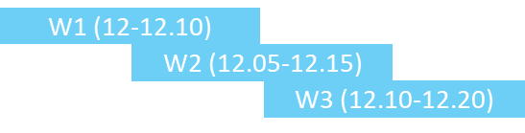
Window Operations
Sliding windows (10 min, 5 min)
Fixed sized window length
Windows are overlapped

Slide 30
Window Operations
Session windows
Session window has a dynamic size of the window length, depending on the inputs.
A session window starts with an input, and expands itself if following input has been received within gap duration

Slide 31
Window Operations
Count words within 10 minute windows, updating every 5 minutes
words = ...
windowedCounts = words.groupBy(
window(words.timestamp, "10 minutes", "5 minutes"),
words.word
).count()

Slide 32
Thank you!

